Slide 1
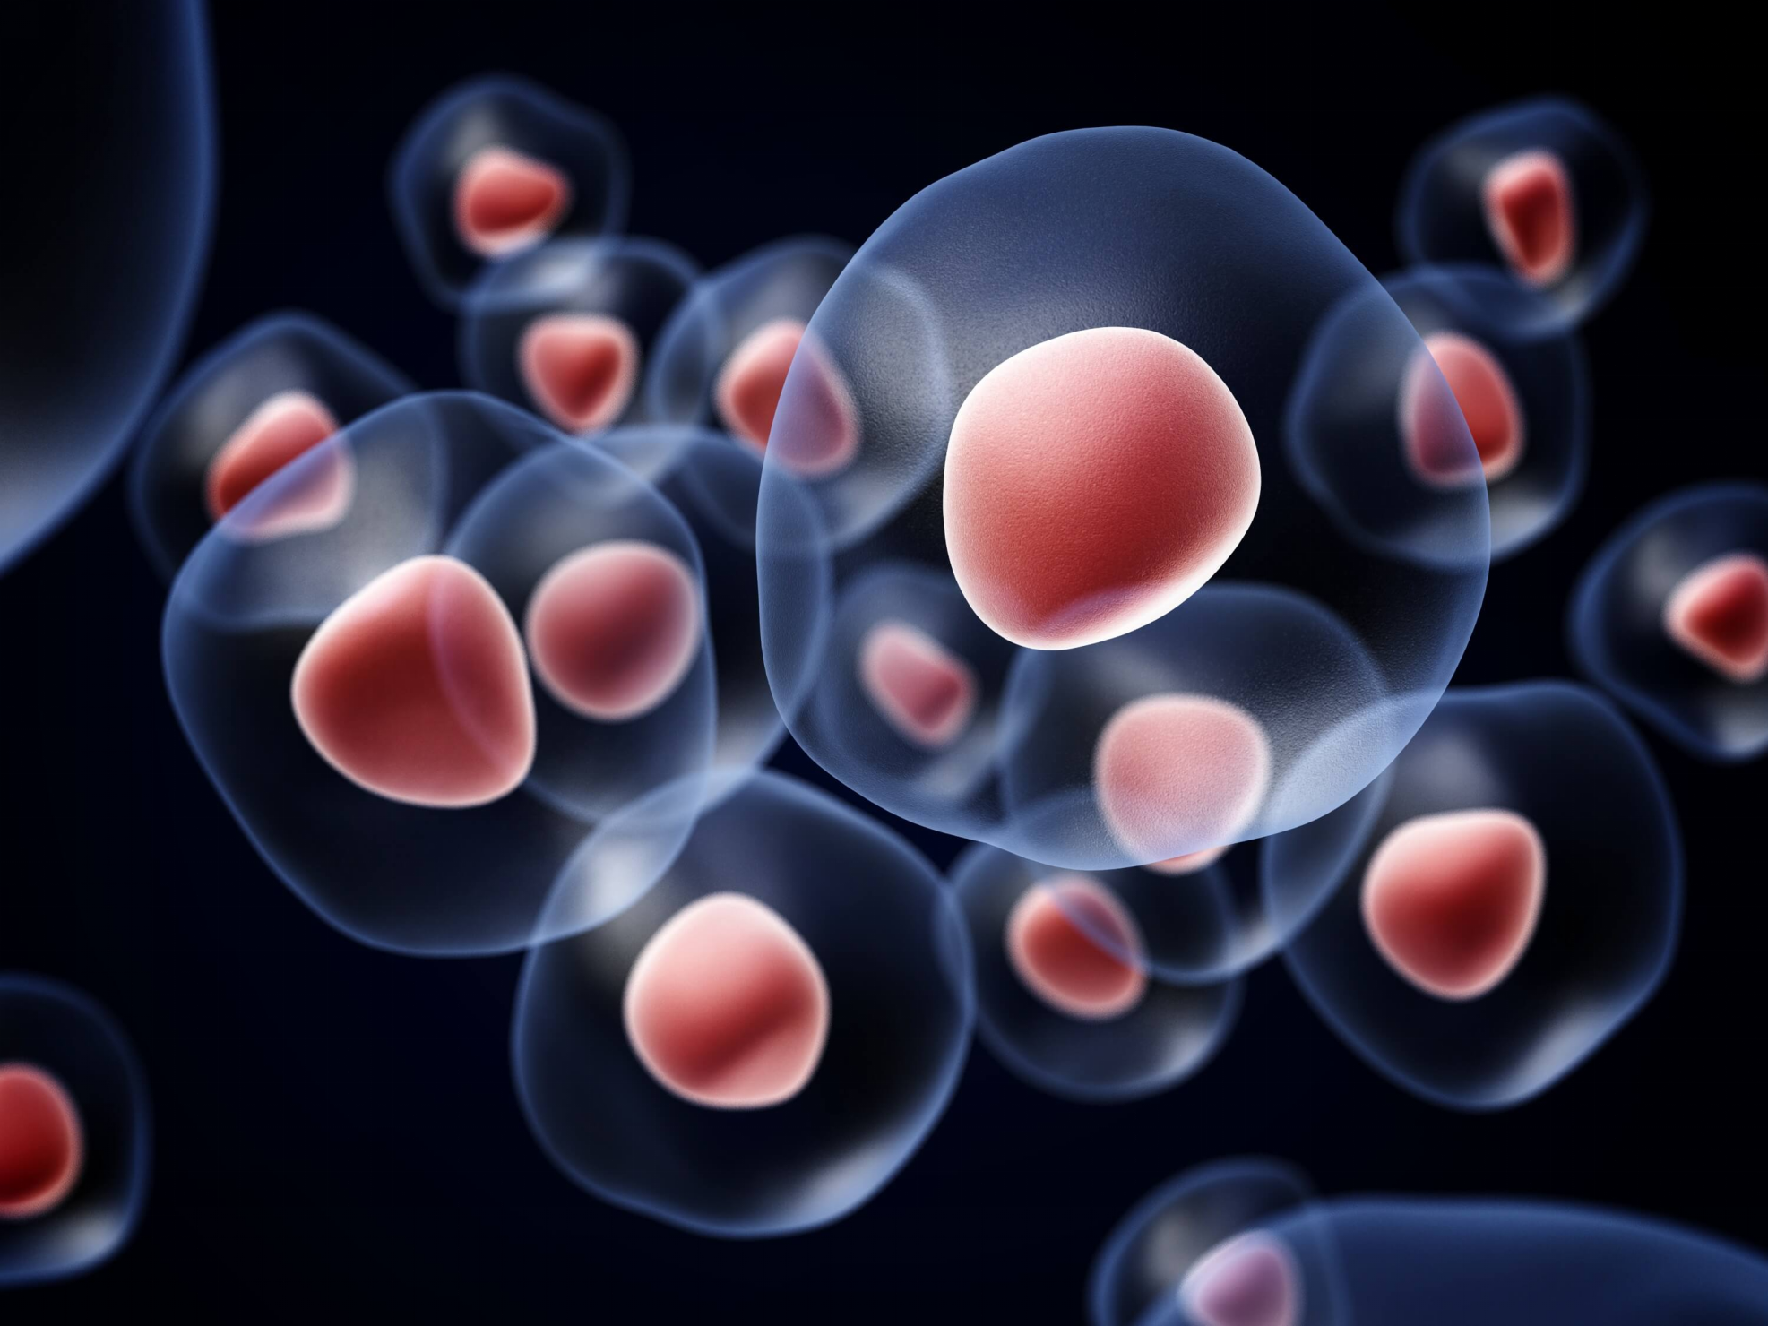
STEM CELLS & THEIR APPLICATIONS

Slide 2
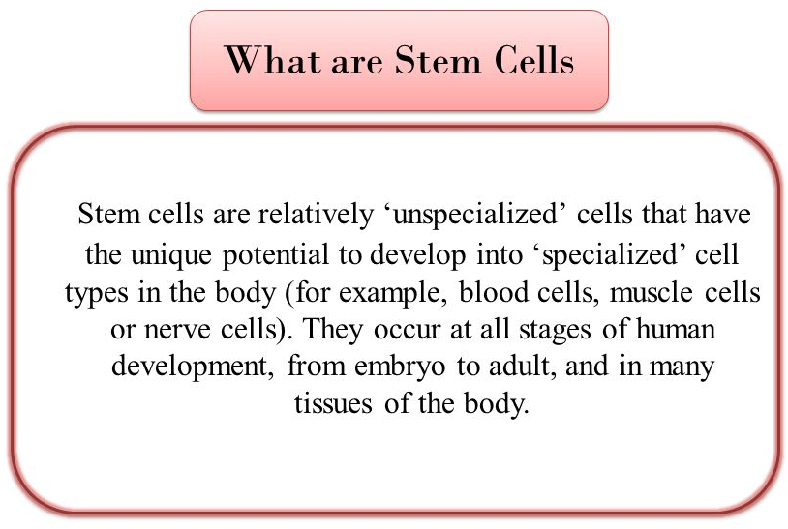
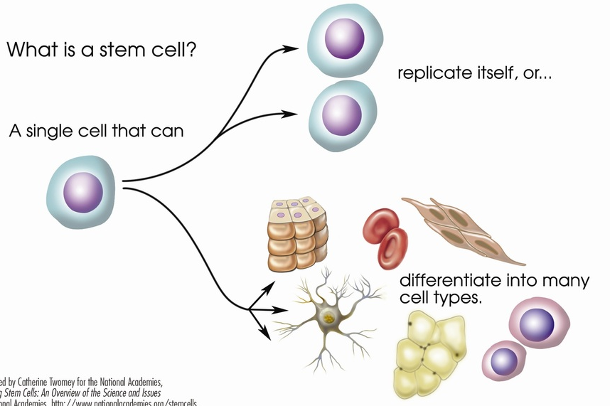

Slide 3
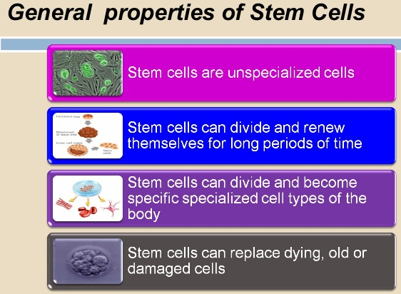

Slide 4
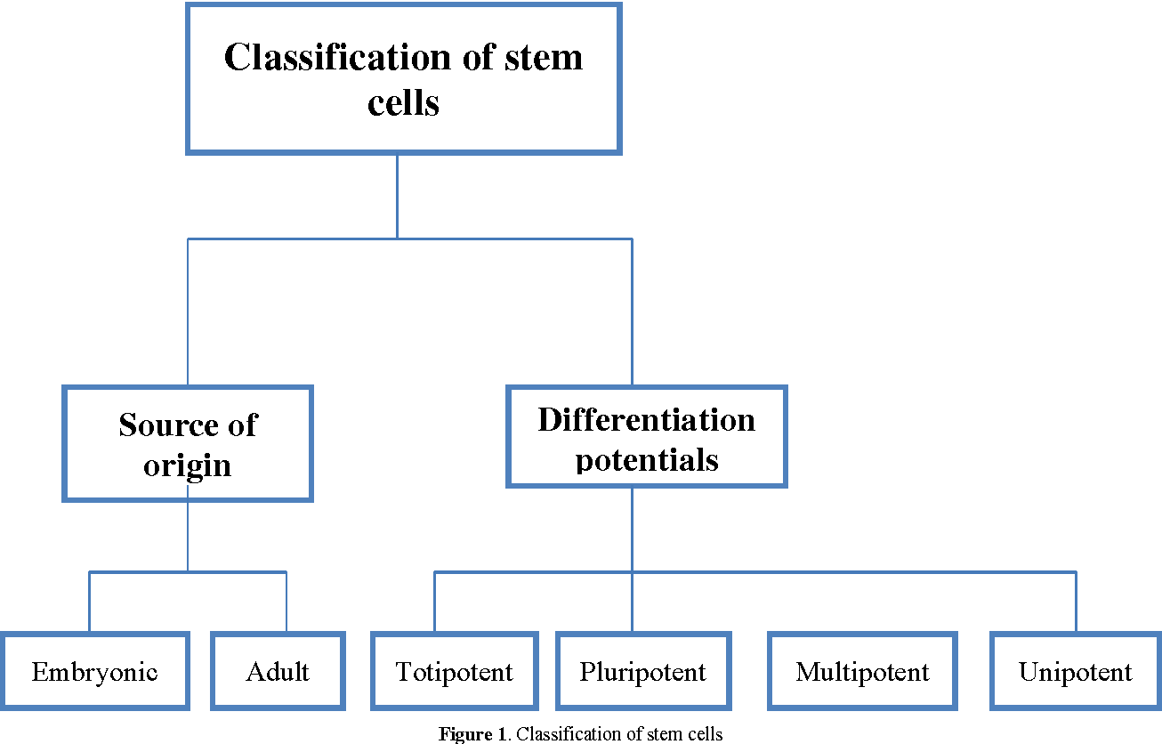
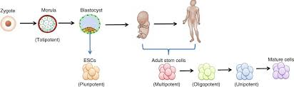
Notes:
The traditional developmental dogma follows the differentiation of totipotent stem cells to pluripotent stem cells (PSCs), PSCs to multipotent stem cells, multipotent stem cells to unipotent stem cells and finally mature cells. Both the self-renewal capacity and differential potential are reduced during their journey from totipotent to mature cell state.
Cells that have the ability to differentiate into every type of cell in the body (including extraembryonic membranes like placenta) are called totipotent stem cells. Eg: zygote and first few cells that result from division of zygote.
Cells that can differentiate into all types of cells except placenta are called pluripotent stem cells. Eg: Cells present within the blastocyst (Inner cell mass).
Cells that can differentiate into a closely related family of cells are called multipotent stem cells. Eg: Blood stem cells
Cells that can differentiate into only one cell type, but have the property of self-renewal required to be labelled a stem cell are called unipotent stem cells. Eg: muscle stem cells

Slide 5
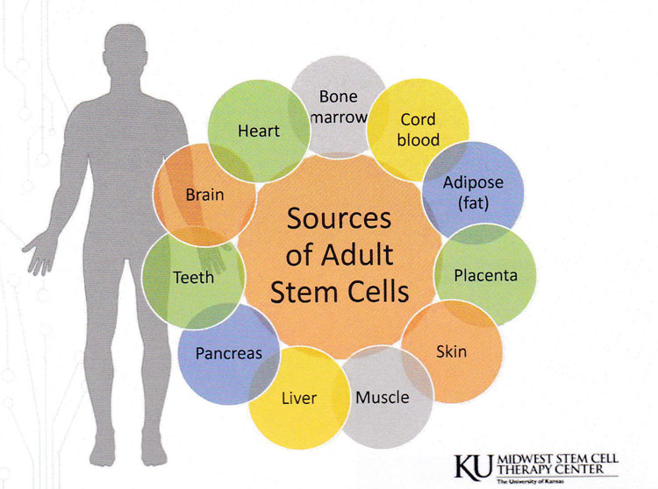
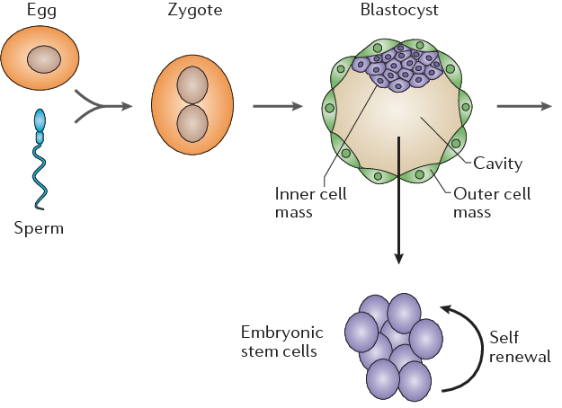
SOURCES OF STEM CELLS
Embryonic stem cells
Adult stem cells

Slide 6
DIFFERENCES BETWEEN EMBRYONIC AND ADULT STEM CELLS
 | EMBRYONIC STEM CELLS | ADULT STEM CELLS
SOURCE | EMBRYO | ADULT TISSUE
POTENCY | TOTIPOTENT / PLURIPOTENT | MOSTLY MULTIPOTENT
CELL CULTURE | EASY | CHALLENGING
 | FLEXIBLE | LESS FLEXIBLE
 | IMMORTAL | MORTAL WITH FINITE LIFE TIME
 | AVAILABLITY | LIMITED QUANTITY
 | DIFFICULT TO DIFFERENTIATE UNIFORMLY INTO TARGET TISSUE | INDUCEMENT IS SIMPLER
 | IMMUNOGENIC | NON IMMUNOGENIC
 | TUMORIGENIC | NON TUMORIGENIC
 | ISOLATION LEADS TO DESTRUCTION OF EMBRYO, HIGH ETHICAL CONTROVERSY | RELATIVE EASE OF PROCUREMENT, LESS MORAL & LEGAL CONTROVERSY

Slide 7
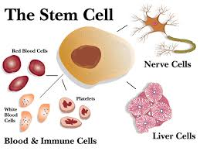
APPLICATION OF STEM CELLS
Gene therapy
Therapeutic cloning
Regenerative medicine

Slide 8
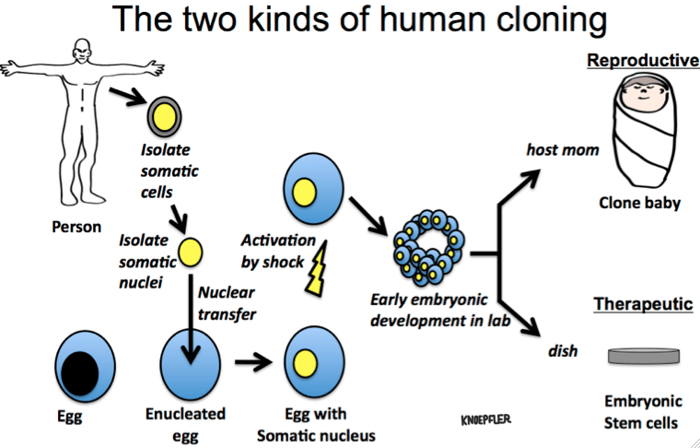
THERAPEUTIC CLONING (Somatic Cell Nuclear Transfer)
Notes:
Therapeutic Cloning- Somatic Cell Nuclear Transfer
Involves enucleation of a somatic cell.
Introduction of required nucleus into the enucleated cell.
This egg is allowed to divide and grow
At this stage stem cells are derived and used for treatments.
Reproductive cloning: This egg is implanted in a surrogate mother to grow a baby.
Eg: In vitro fertilization
The first successful experiment produced a female sheep named Dolly

Slide 9
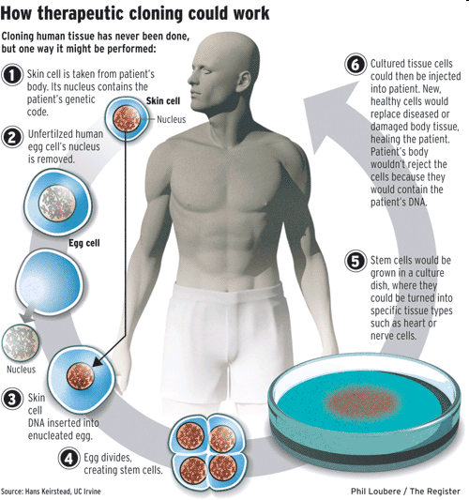

Slide 10
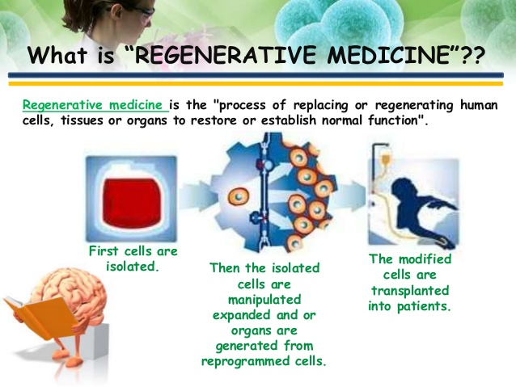
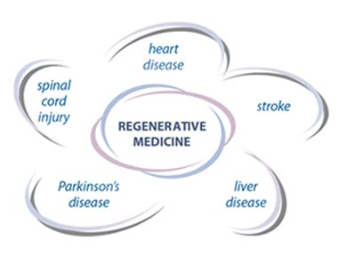
REGENERATIVE MEDICINE

Slide 11
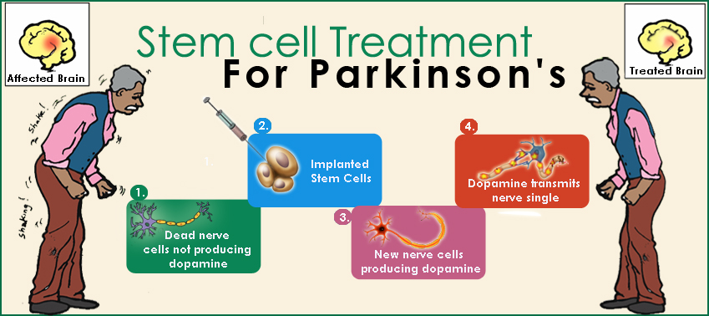

Slide 12
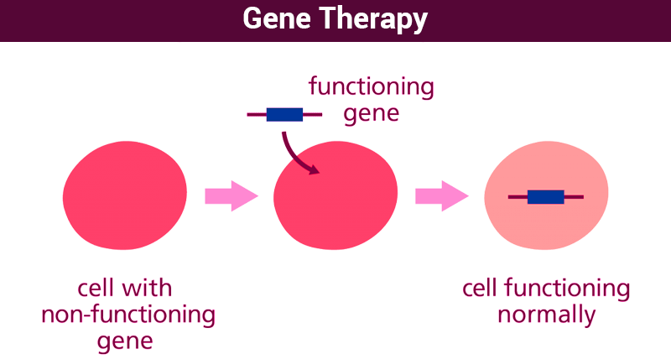
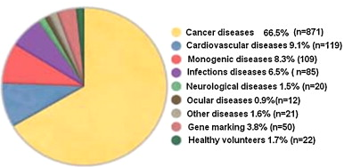
GENE THERAPY
Gene therapy is insertion of genes into an individual’s cells and tissue to treat a disease
Mostly is being used to treat cancer, infectious diseases, heart diseases, arthritis, Alzheimer's disease etc.

Slide 13
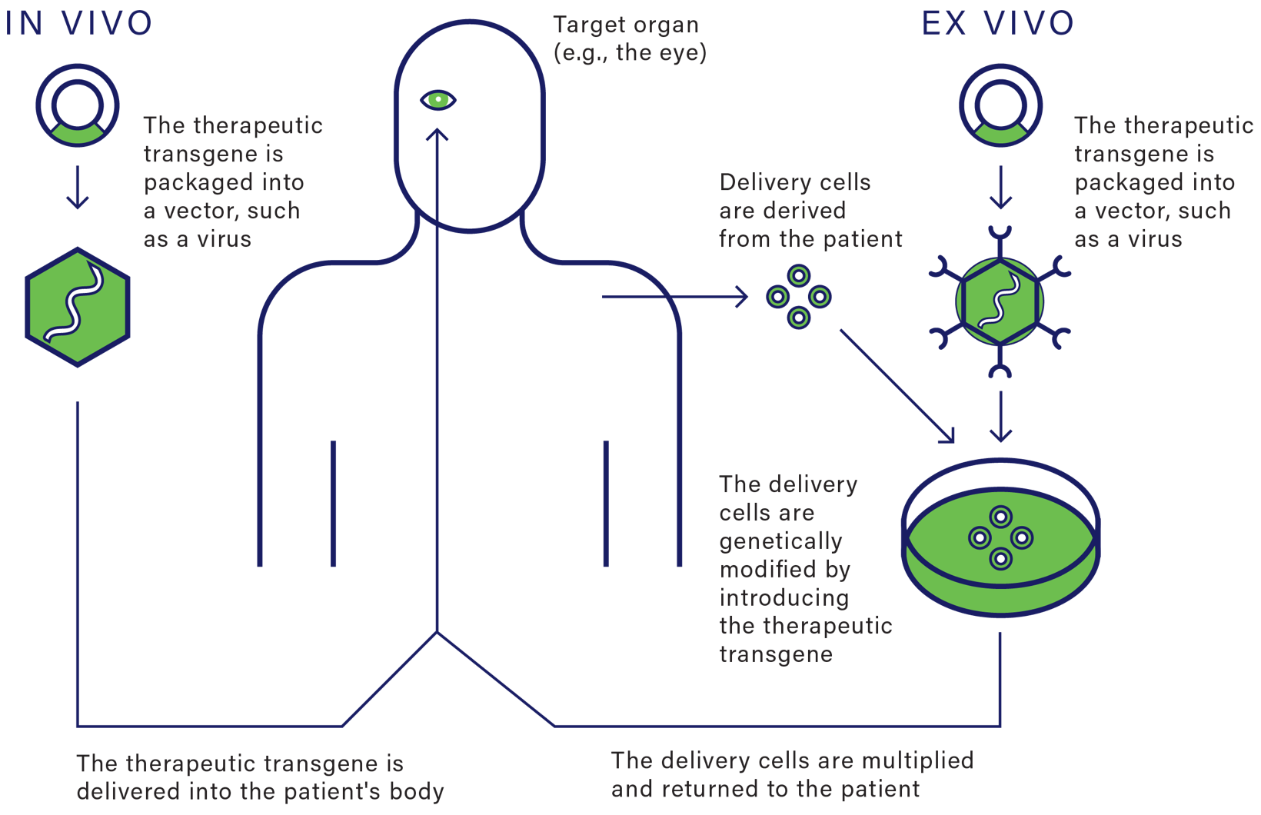
STRATEGIES FOR GENE THERAPY

Slide 14
QUESTIONS
What are stem cells and their properties?
How are stem cells classified on the basis of potency?
How are stem cells classified on the basis of sources ?
What is gene therapy? Explain the ex-vivo gene therapy.
How stem cells are used for therapeutic cloning?
What is regenerative medicine and how stem cells can be used in it?

